Slide 1
Playwriting, Screenwriting, Storyboarding
“After nourishment, shelter, and companionship; stories are the thing we need most in the world.” – Philip Pullman

Slide 2
Vocabulary
Plot: the arrangement of the incidents that take place in a play.
Exposition: detailed information revealing the facts of the plot.
Climax: turning point in the action of a play.
Antagonist: the character opposing the protagonist.
Theme: the basic idea or purpose of the play. It ties together all the characters and events.
Spectacle: all visual elements of production, such as scenery, properties, lighting, costumes, makeup, stage movement, and dance.

Slide 3
Vocabulary
Act: major division of a play.
Tragedy: a play that deals with a serious situation in a serious way. The protagonist dies or is defeated at the end of the play.
Comedy: a play that presents its theme and characters in a humorous way. All characters come together at the end of the play.
Melodrama: an exaggerated, fast-moving play in which action is more important than characterization. The “good guys” win and the “bad guys” are punished.

Slide 4
Vocabulary
Cues: the dialogue, sounds, movement, or business signaling an actor or technician to respond as rehearsed.
Subtext: the underlying meaning or interpretation of a line, which is not indicated in the script but is supplied by the actor.
Business: small movements and actions that do not require the actor to move from place to place.
Storyboard: a sequence of drawings, typically with some directions and dialogue, representing the shots planned for a movie or television production.

Slide 5
Lesson Objectives
Understand the dramatic structure of a play.
Recognize several types of plays.
Understand how a play is organized.
Learn how to analyze a play.
Develop a screenplay.
Create a storyboard for film/television.

Slide 6
The Structure of Plays
A play is a story written in dialogue form to be acted out by actors before a live audience as if it were real life.
Plays have distinguishing characteristics that make up the play’s dramatic structure.

Slide 7
The Elements of a Play
The six basic parts of dramatic structure:
Plot
Character
Theme
Language
Music
Spectacle

Slide 8
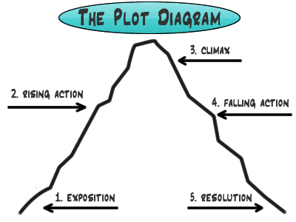
Plot
Arrangement of the incidents that take place in the play.

Slide 9
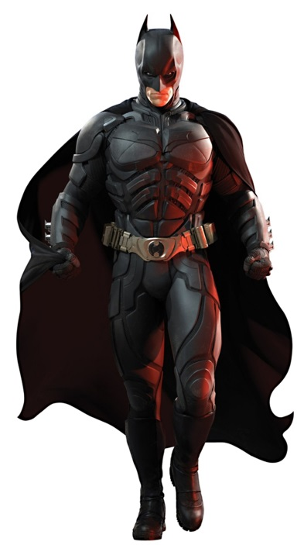
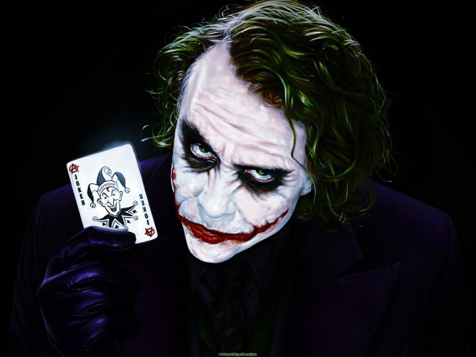
Character
The principal character who represents the main thought of the play is the protagonist, and the opposing character is the antagonist.

Slide 10
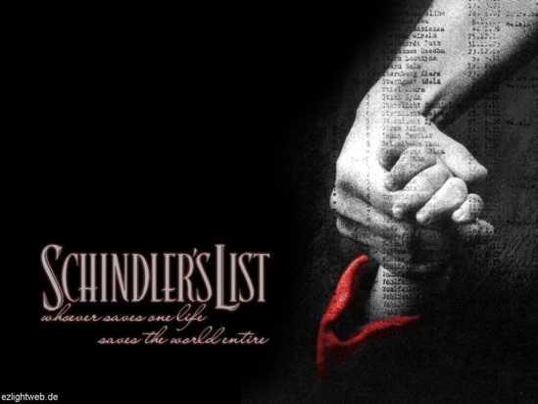
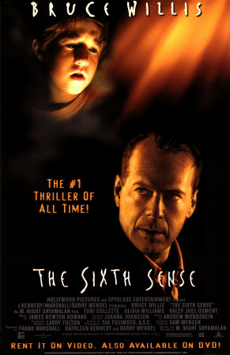
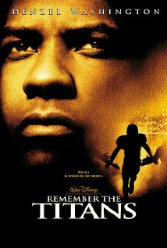

Theme
The overall meaning, or basic idea that the playwright wishes to get across through the play.

Slide 11
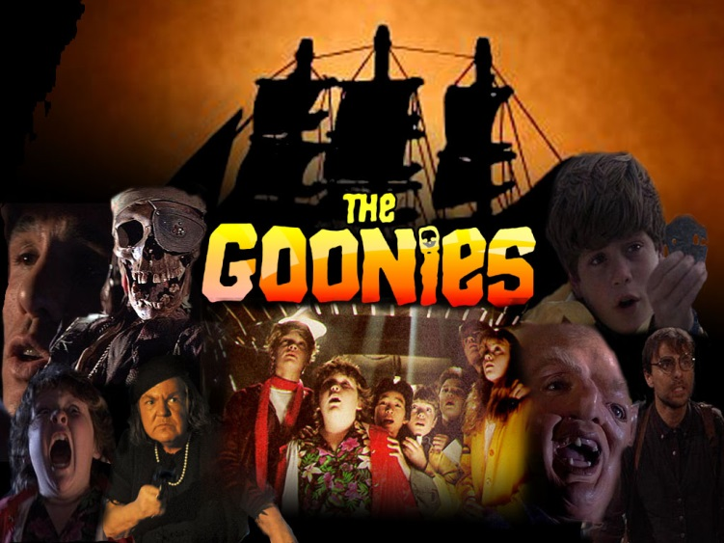
Guess the Themes
Adventure
Friendship
Courage
Dreams
Empowerment

Slide 12
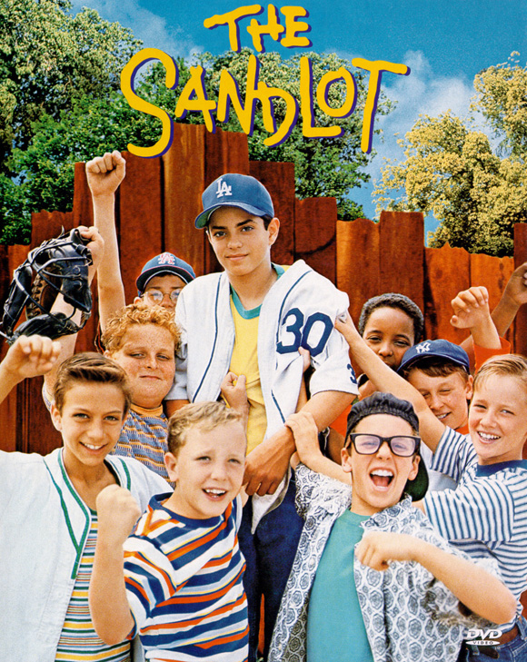
Guess the Themes
Friendship
Youthful Exuberance
Naivety
Acceptance
Baseball

Slide 13

Guess the Themes
Memory and the Past
Fear
Good vs. Evil
Friendship
Time
Family
Justice and Judgment

Slide 14
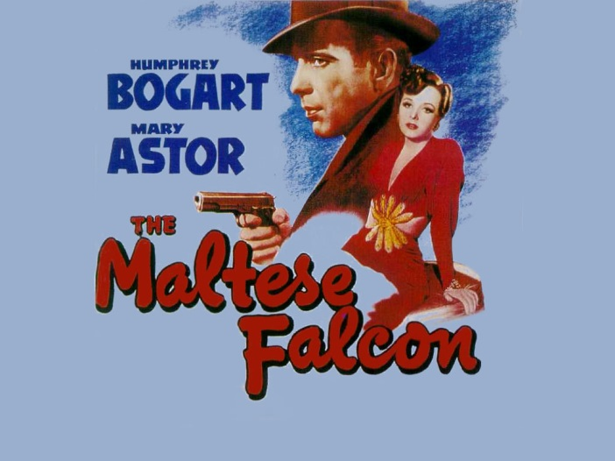
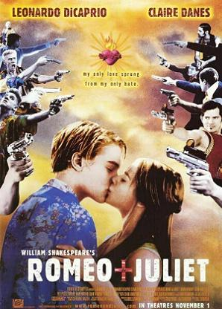
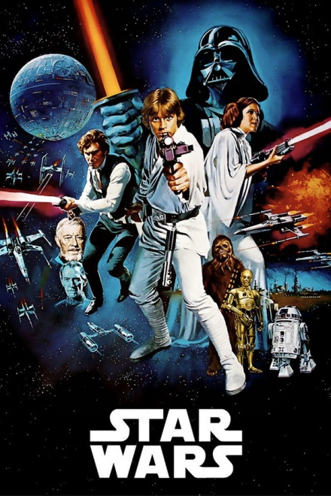
Diction / Language
The playwright tells the story through words, or language. Language gives the audience a better understanding of the type of play.

Slide 15
The Maltese Falcon
The following is a clip from the motion picture The Maltese Falcon. This style of cinema is known as “film noir,” French for “black film.” This is a style that refers to mostly black and white films that contain bleak subject matter and a somber tone.
Pay close attention to the style of the voice, which is easily recognizable for this cinematic genre.

Slide 16
Diction / Language

Slide 17
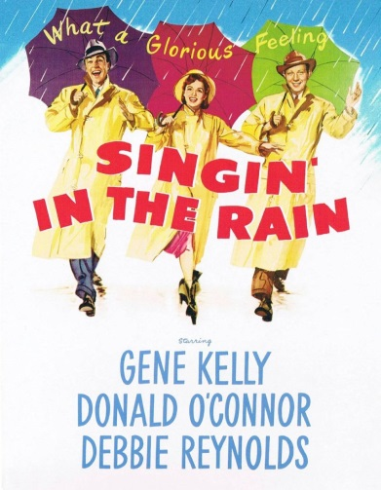
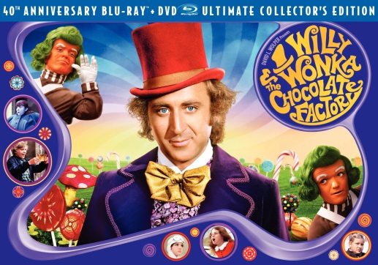
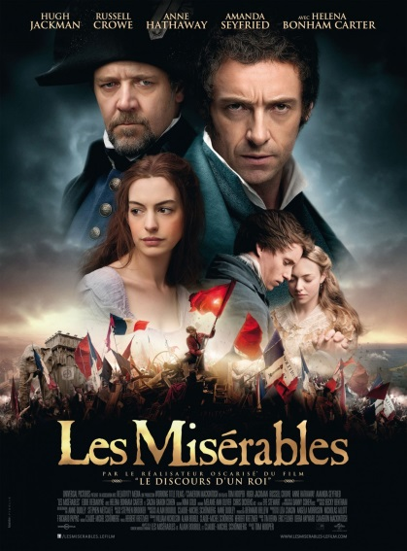
Song / Music
The sound and characteristics of the actors’ voices, as well as songs, instruments, background music and sound effects.

Slide 18
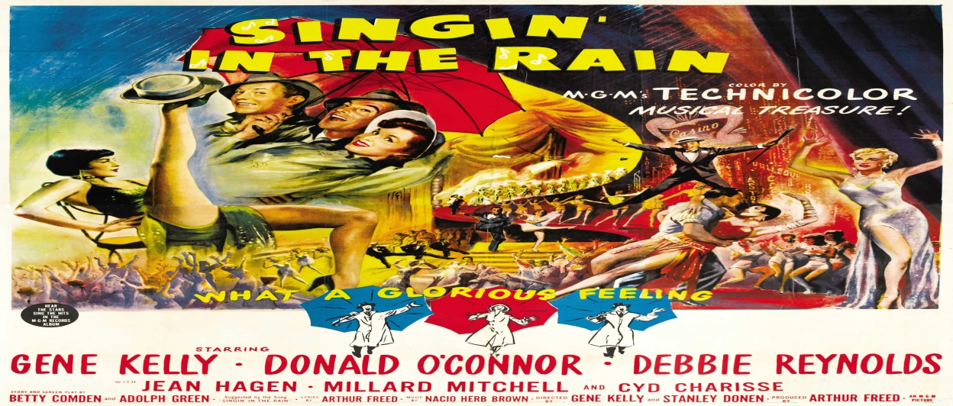
Song / Music
Song / Music is easily identifiable for its explicit use in the genre of musical theatre or cinema.
It should be noted though, that song / music does not pertain just to actual singing itself. It includes the use of background music, sfx, or the voices of the actor(s) as well.
The following clip is from Singin’ In The Rain starring Gene Kelly, Donald O’Connor, and Debbie Reynolds.

Slide 19
Song / Music

Slide 20

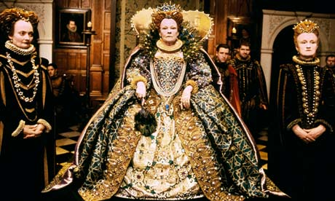
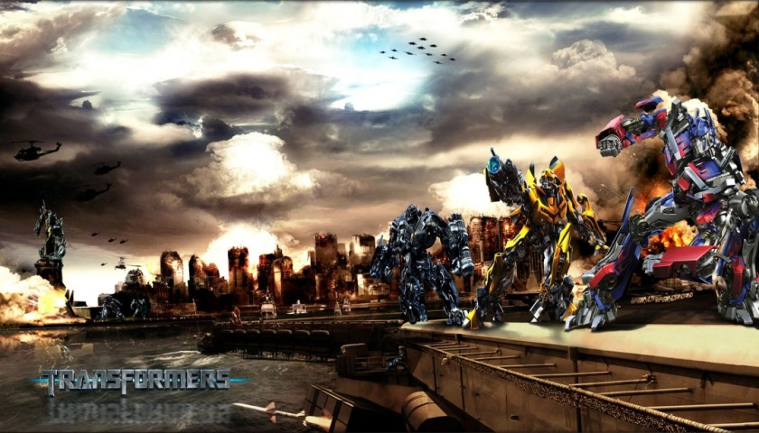
Spectacle
All visual elements of a production including scenery, properties, lighting, costumes, makeup, stage movement, and dance.

Slide 21

Spectacle
The following is a clip from the movie Transformers.
Take note of how the camera angles help enhance the characteristic of spectacle to the scene.

Slide 22
Spectacle

Slide 23
Analyzing & Researching the Play
Here are some questions to consider in analyzing the play:
What were the major world events at the time of the play?
What were the social customs of the time?
What type of clothing was worn?
What music was popular?
What famous political or social characters were popular?
In what type of dwelling or shelter would the characters have lived?
What type of food was eaten?
What are the job opportunities for the characters?
What is the character’s relationship to society?

Slide 24
Analyzing & Researching the Play
It is important to understand the meaning behind the words and actions of each line. This is called subtext.
How does subtext affect the character’s objectives, obstacles, and tactics?
How are the lines different from the actions? (Remember: it’s a stronger choice to judge a character by their actions, not by the words they say.)

Slide 25
Analyzing & Researching the Play
As you begin to work on your screenplay and storyboard, visualize the characters’ movements and personal business (mannerisms, actions, or use of props).

Slide 26
Screenplays
Screenplays are a bit different from stage plays. They both contain directions, however, in a screenplay the directions focus mainly on the view of the camera.
No longer are we dealing with stage right, stage left, etc.
We must now become accustomed to high-angle shot, low-angle shot, cut to, interior, exterior, etc.

Slide 27
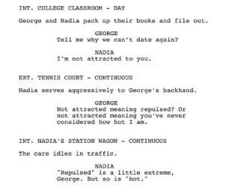
Screenplay Examples
Notice how everything is mainly centered in a screenplay.

Slide 28
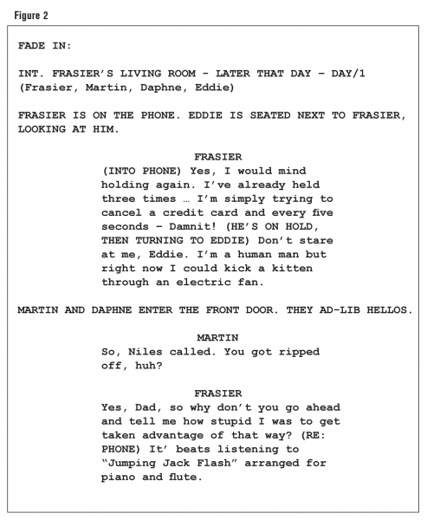
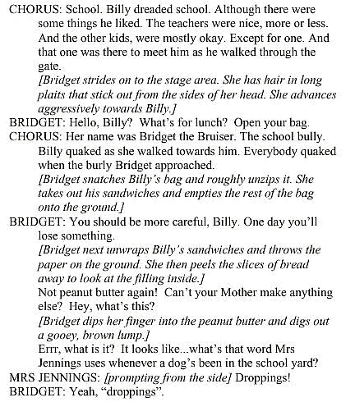
Screenplays vs. Stage Plays
What differences / similarities do you notice?
Screenplay
Stage play

Slide 29
DO NOW DO NOW
Take out your Hero’s Journey homework for review!
Continue the process of making your myth part of the HERO’s JOURNEY!
When finished,
grab a CHARACTER GUIDE!

Slide 30
DO NOW DO NOW
Take out the following;
Hero’s Journey Plot Organizer
Character Archetype Worksheet
Rough drafts Script Samples (if applicable)
Mr. Seidel will check for HW completion

Slide 31
DO NOW DO NOW
Take out the following;
Drama Portfolio
Hero’s Journey Organizer
Today we will be…
STORYBOARDING SCENE 2
(Stages 4-6)
4. Meeting the Mentor
5. Crossing the Threshold
6. Test, Allies, Enemies

Slide 32
Storyboarding
A storyboard is a sequence of drawings, typically with some directions and dialogue, representing the shots planned for a movie or television production. Much like a comic strip.
However, a storyboard for a film specifically has additional markings to show the camera angles or directions of camera movements.
A storyboard is absolutely necessary to filmmakers. Think of it as a game plan of how the film is going to be shot.

Slide 33
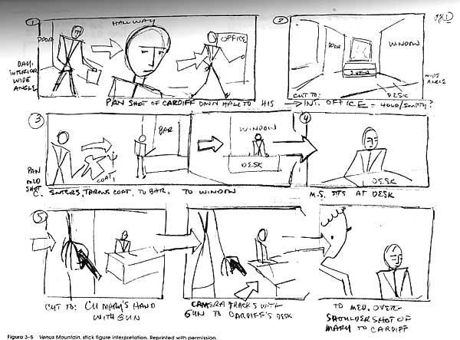
Storyboarding

Slide 34
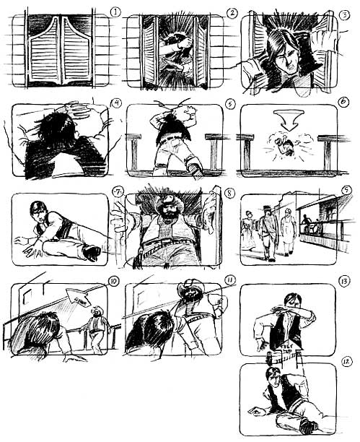
Storyboarding

Slide 35
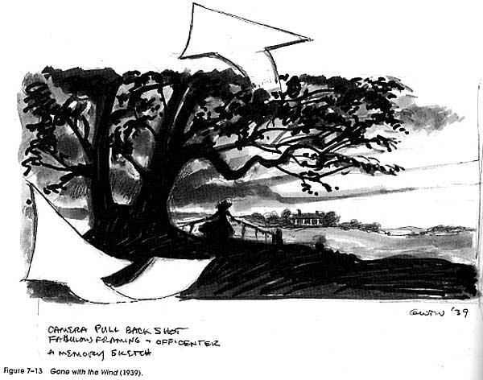
Storyboarding

Slide 36
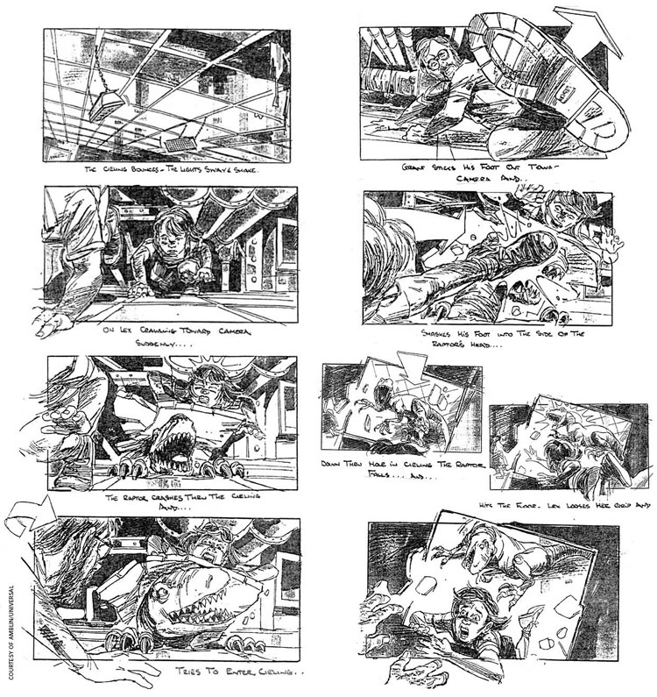
Storyboarding

Slide 37
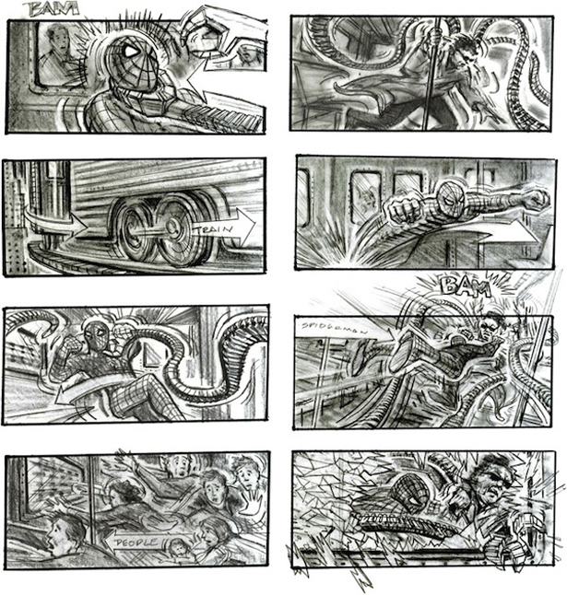
Storyboarding

Slide 38
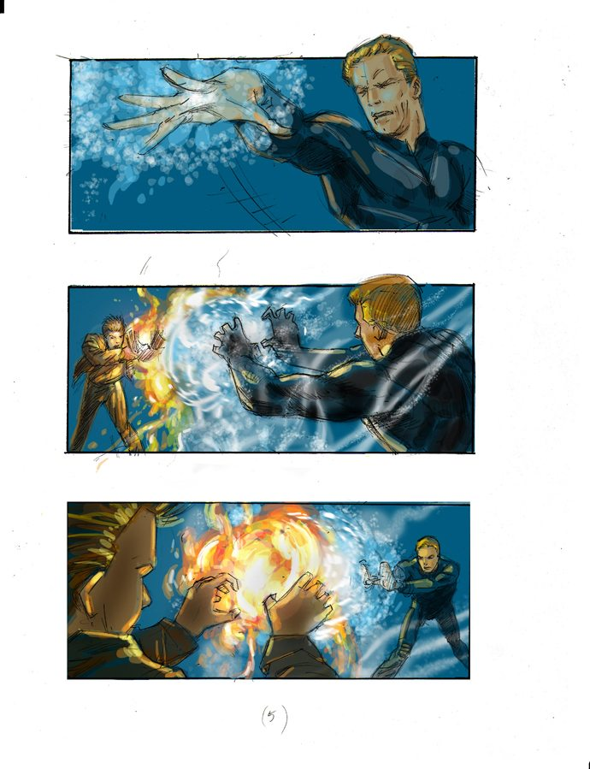
Storyboarding

Slide 39
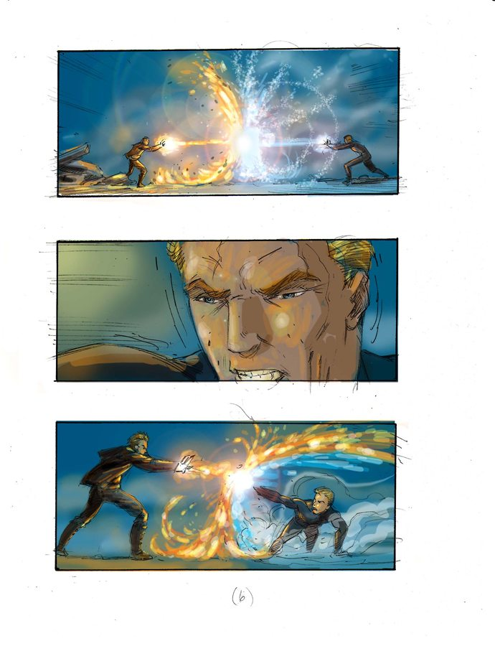
Storyboarding

Slide 40
Storyboard Project
You will need to pick a short scene (2-3 minutes in length) from your Monomyth
You will need to create a rough copy of the script. Be sure to include necessary screenplay vocabulary using the screenplay vocabulary worksheet.
You will each need to storyboard 6 shots of the scene. Be sure to include bits of dialogue from the scene, at the bottom of the picture to show what part of the scene the storyboarded shot is from.
Your storyboard does not have to be colored, but it must be neat and convey a clear story.

Slide 41
Storyboarding

Slide 42
Essential Questions
Explain the elements that make up the dramatic structure of a play.
How does researching the play benefit all collaborators working on the project?
What is the purpose of a storyboard?

